Slide 1
Group 3: GAI for Education
Michael Soebroto, Mohnish Sai Prasad, Rithesh Kumar
Bi-weekly Update Week 9

Slide 2
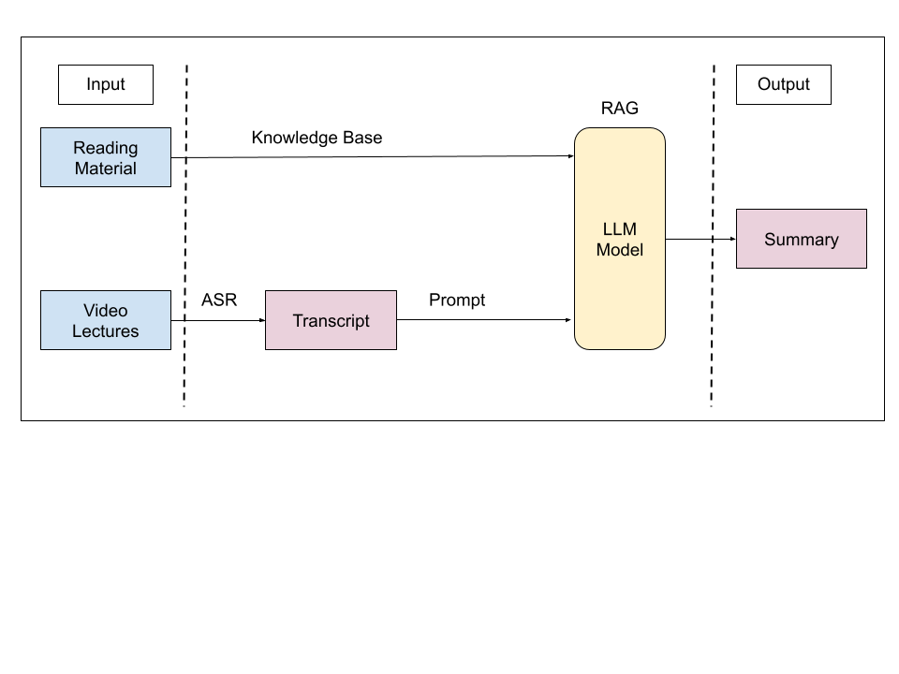
Updated pipeline - RAG
Generating the summaries separately for video and reading materials can lose information from the reading material.
Propose a RAG model which uses the reading material as a knowledge base
Use an LLM to generate a summary of the video transcript with access to the knowledge base
Train the LLM to fetch additional information from the knowledge base and refine the Summary

Slide 3
Project Status
Current status
Compared Llama 2 vs GPT 3.5
Performed few shot learning using GPT 3.5 on subset of our dataset
Changes from last time
Changed the workflow: Instead of summarizing separately, we create a summary from the video transcript, with the help of RAG using the reading material as a knowledge base to enhance the quality of the summary.
Finish up the human-generated summaries
Trained using Few-shot learning on the GPT 3.5 model
Plan for next cycle
Setup final evaluation survey and work on final presentation

Slide 4
Individual Status
Team Member | What I did in the last two weeks
Michael | Creating human-generated summaries for few-shot training and for the final evaluation Evaluate the Enhance GPT 3.5 using BertScore Fixing few-shot training for Llama 2
Mohnish | Compared performance of Llama 2 with GPT 3.5 and BARD on various data examples Curated and organized training data for few shot prompting Fixing few shot prompting for Llama 2 model using Olama
Rithesh | Prompt engineering to find the best prompt for the problem. Fine-tune the RAG system with Few-shot training on ChatGPT 3.5 Turbo model. Evaluate the model results with BERTScore.

Slide 5
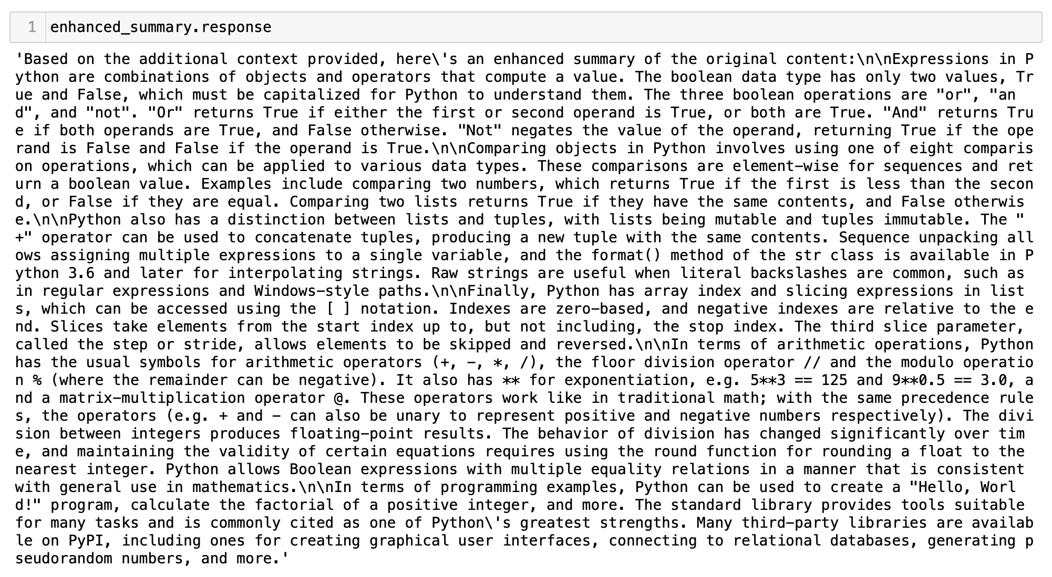
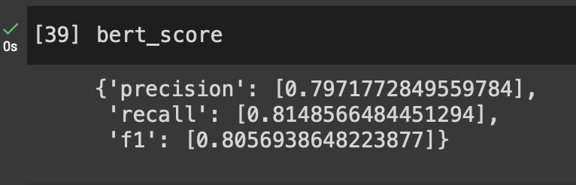
Interesting Findings - Llama 2

Slide 6
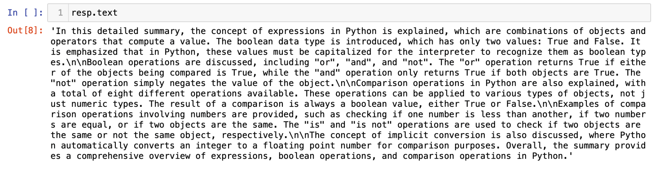
Interesting Findings - GPT 3.5 (naive)

Slide 7
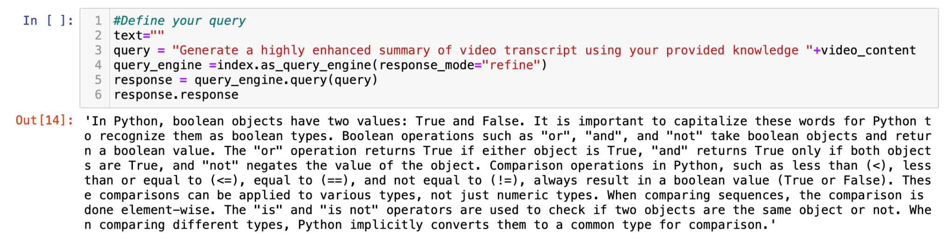
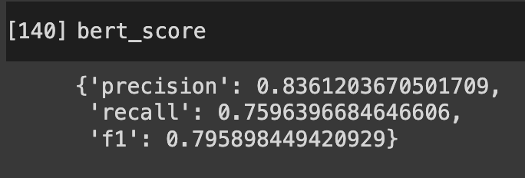
Interesting Findings - GPT 3.5 (enhanced)

Slide 8
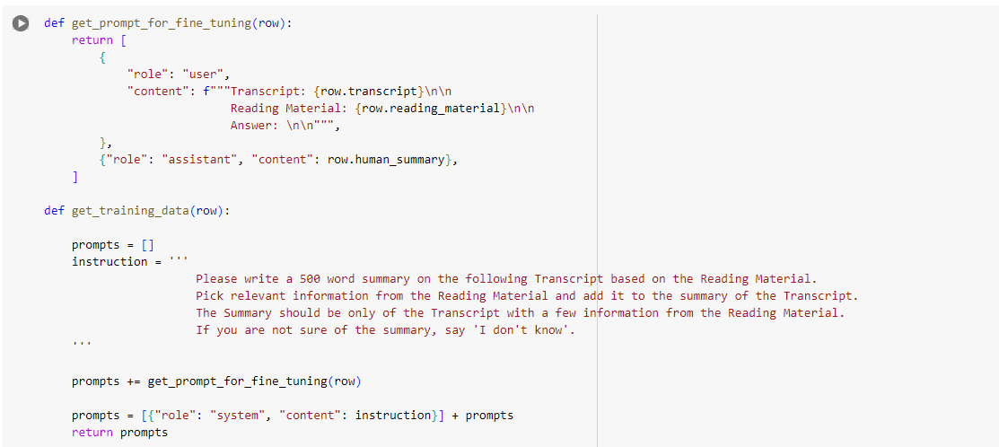
Interesting Findings - GPT 3.5 with Reading Material
Prompt

Slide 9
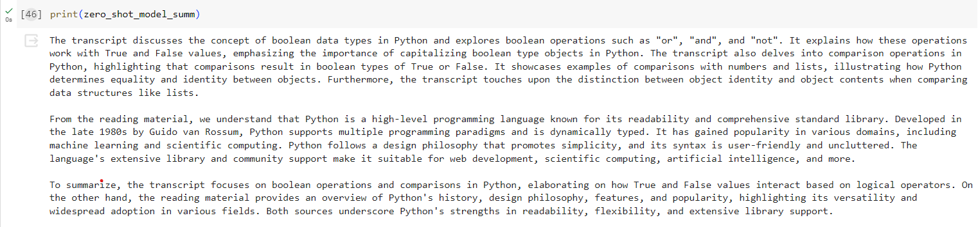
Interesting Findings - GPT 3.5
Interesting Findings - GPT 3.5 with Reading Material
Zero-shot trained model

Slide 10
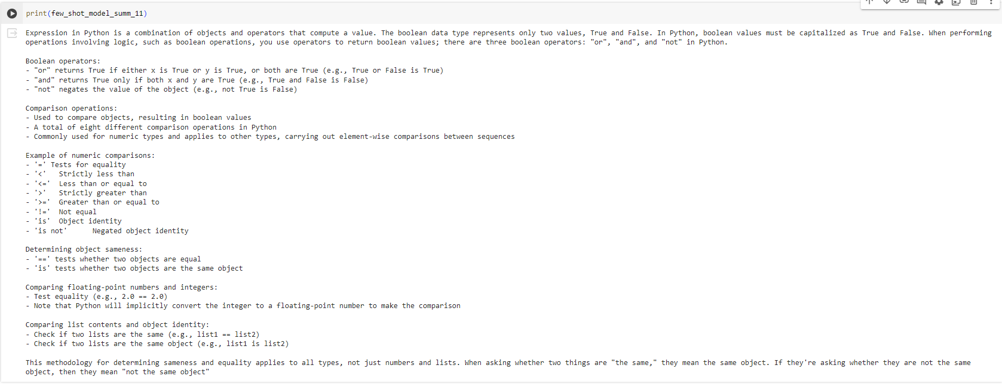
Interesting Findings - GPT 3.5
Interesting Findings - GPT 3.5 with Reading Material
Few-shot trained over 11 data points

Slide 11
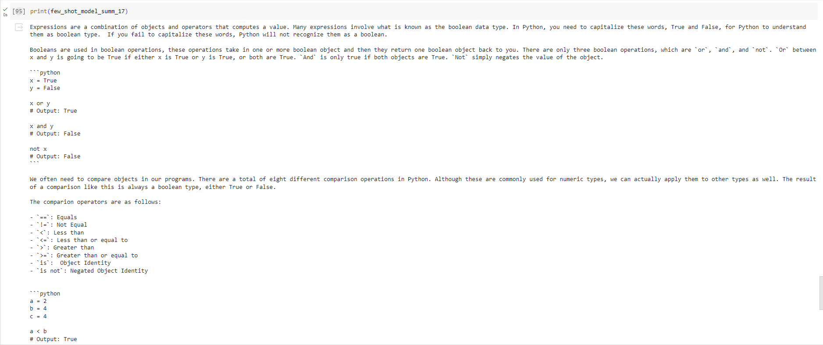
Interesting Findings - GPT 3.5
Interesting Findings - GPT 3.5 with Reading Material
Few-shot trained over 17 data points

Slide 12
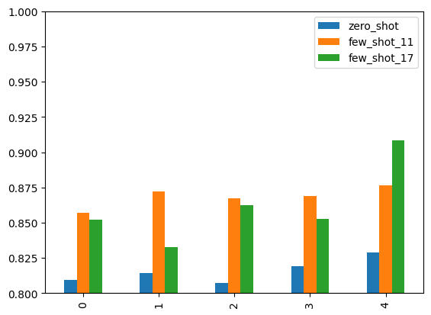
Interesting Findings - BERTScore (F-1)

Slide 13
Schedule
Updated Timeline
Week 9: Set up the evaluation survey and send it out
Week 10: Final touches and presentation

Slide 14
Thank You

